Slide 1



Components of Evolutionary Algorithms
Group 3
Ashley Bedford
Rehmana Younis
Robert Romanski

Slide 2

Definition
Evolutionary Algorithm
An algorithm that:
Defines a population as a set of solutions (set of chromosomes) and
Applies the Darwinist Principle of “Survival of the Fittest” over a period of time that
Optimizes a Fitness Function to output a globally optimal solution.

Slide 3
Definition
Parent Selection
Parents
Initialization
Population
Recombination
Mutation
Termination
Offspring
Survivor Selection

Slide 4
Agenda
Types of Representation
Parent Selection
Selection Pressure
Population Management

Slide 5

Types of Representation
Action
Real-world (phenotypes) → Computer (genotypes) Population Mapping
Encoding (Phenotype → Genotype)
Decoding (Genotype → Phenotype)
Comparison
1 Phenotype per 1 Genotype
#1
#2
Phenotype
A B C D F G
Encode
→
=
→
Decode
1 0 1 1 0 0
Genotype

Slide 6
Types of Representation
All Possible Solutions
Candidate Solution
Phenotype
Individual
Phenotype Space: The space of all possible solutions.
A
8
B
A B C D
6
1
10
A D C B
Candidate Solution
2
C
D
B C A D
5
The Traveling Salesman
Phenotype Space

Slide 7
Types of Representation
Evolutionary Search Points
Genotype
Chromosome
Individual
Genotype Space: The space to conduct evolutionary search.
A
8
B
1 0 0 1
6
1
10
1 1 0 1
Chromosome
2
C
D
0 1 1 1
5
The Traveling Salesman
Genotype Space

Slide 8
Types of Representation
Elements of Individuals
Variable
Locus (plural: loci)
Position
Gene
Value
Allele
1 0 0 1
1 1 0 1
Gene
0 1 1 1

Slide 9

Parent Selection Types
1. Roulette Wheel Selection
2. Stochastic Universal Sampling (SUS)
3. Tournament Selection
4. Rank Selection
5. Random Selection

Slide 10
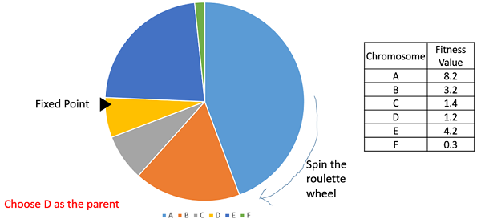
Parent Selection Types
1. Roulette Wheel Selection
Based on the fitness values a wheel is created with the highest fitness value occupying the most significant space. The wheel is spined across a fixed point and the pointed region is chosen as the parent. The process continues for the selection of a second parent.
Spin the Roulette Wheel
Chromosome | Fitness Value
A | 8.2
B | 3.2
C | 1.4
D | 1.2
E | 4.2
F | 0.3
Fixed Point
Spin
Choose D as the Parent

Slide 11
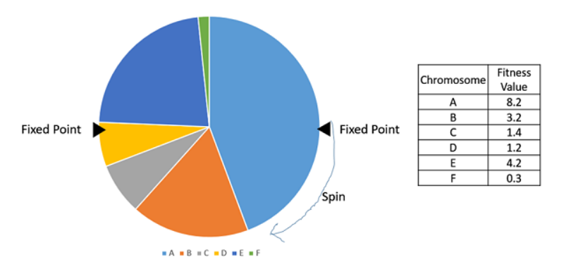
Parent Selection Types
2. Stochastic Universal Sampling (SUS)
While SUS is like Roulette Wheel Selection, there are multiple fixed points for multiple parents' selection simultaneously.
Fixed Point
Fixed Point
Chromosome | Fitness Value
A | 8.2
B | 3.2
C | 1.4
D | 1.2
E | 4.2
F | 0.3
Spin
Choose D as the Parent

Slide 12
Parent Selection Types
3. Tournament Selection
The best parent is selected from K individuals in K-Way tournament selection. Process continues for next parent's selection.
Fitness Value
1
5
9
8
7
4
2
3
6
2
2
1
0
Chromosome
Q
A
Z
W
S
X
E
F
R
T
Y
U
I
A
Select K Chromosomes at random
Pick the best as parent
A
E
T

Slide 13
Parent Selection Types
4. Rank Selection
When the population fitness values are very closed, or may encounter negative values, rank selection can be the best choice. According to different values, no matter how close they are in terms of their floating-point values, ranks are allocated, and based on their ranks area is assigned on the wheel.
Chromosome | Fitness Value | Rank
A | 8.10 | 1
B | 8.00 | 4
C | 8.05 | 2
D | 7.95 | 6
E | 8.02 | 3
F | 7.99 | 5

Slide 14
Parent Selection Types
5. Random Selection
In this selection methodology, parents are selected randomly from the population without keeping and consideration of their fitness values. This approach is usually avoided.

Slide 15
Population Management Models
Types of Models
Generation Model:
Each chromosome survives for only one generation.
The off-springs replaces the entire generation
Non-overlapping population
Steady State Model:
A single individual which can be random or the worst one is selected and replaced by one off-spring.
Overlapping population
10010
01001
11001
10111
01000
01011
Selection
Crossover
Mutation
10010
01001
11001
10010
01110
11001
Selection
Crossover
Mutation
Selected

Slide 16
Selection Pressure
Indicator of favoritism towards high fitness
Selects higher fitness via enhanced competition
Too much selection pressure skews the normal distribution curve
Skewed distribution curves can be remedied by increasing crossover
Too much crossover causes insensitivity to the building blocks of future fitness
Reference
Miller, B. L., & Goldberg, D. E. (1996). Genetic Algorithms, Selection Schemes, and the Varying Effects of Noise. Evolutionary Computation, 4(2), 113–131. https://doi.org/10.1162/evco.1996.4.2.113

Slide 17
Selection Pressure
Examples
 | Operating System Prototype | Smartphone Prototype | Medicine Prototype
Competition enhancement for higher fitness. e.g. Tournament of five rather than two chromosomes that have fitter OS phenotypes of: | Networking Filesystem compatibility Driver compatibility Memory management User interface | Screen size Battery capacity GPU speed Memory capacity Screen resolution | Convenience Side affects Effectiveness Supervision requirement Cost
Potential consequence of Distribution Skew. e.g. Some phenotypes may be minimized in the optimal choice | Computationally efficient OS that has the least driver compatibility | High GPU speed with minimal battery capacity | Cheap medicine that must be stored at consistently cold temperatures
Potential consequence of too much crossover. e.g. convergence happens too early thus minimizing selection pressure | Acceptable network capability Compatible with network filesystems Excellent user interface (early convergence) Minimal memory protection Minimal driver compatibility | Large screen size Low battery capacity High GPU speed (early convergence) Acceptable memory capacity High screen resolution | Preferably taken before bed Acceptable side affects Very effective (early convergence) Unclear supervision requirement Acceptable cost

Slide 18
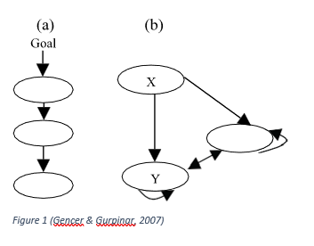
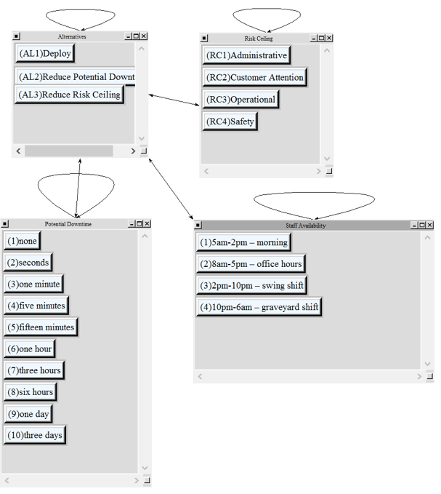
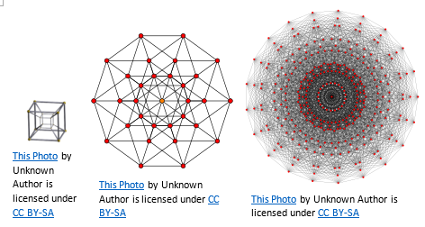
Island Model EAs
Architecture
Interconnected clusters of chromosomes
Similar to: ‘distributed computing’, ‘analytical network process’ (ANP)
Easy to optimize for processing on clustered computing hardware
Hypercube
An ANP model for deciding when to execute risky system processes

Slide 19
Island Model EAs
Operations
Chromosomes are divided into subgroups for space exploration
Fittest chromosomes are moved to other groups after a specified number of generations
e.g. 25 generations
Too much migration is like too much crossover, thus skipping opportunities for special exploration
Small amounts of migration to prevent fast convergence
Differing parameters at each deme (cluster) to reduce premature convergence

Slide 20
Island Model EAs
Examples
Great application for:
Clustered Computing Architecture, & Migrating strong solutions to Neighboring Systems
Vehicle Traffic – traffic solutions at an intersection passed to another intersection
Weather Simulation – passing solved simulation parameters to neighboring weather systems
Data Traffic Management – determining quality of service for incoming traffic patterns

Slide 21
Thank you!

